Slide 1
Idea 1: Fukushima’s Fallout
Creative Brief: Environmental Interaction & Storytelling

Slide 2
Environmental Interaction & Storytelling
The environment is interactable and will tell stories that will help the player understand the story of our game better
Player will have to interact with the environment to progress in the game’s flow

Slide 3
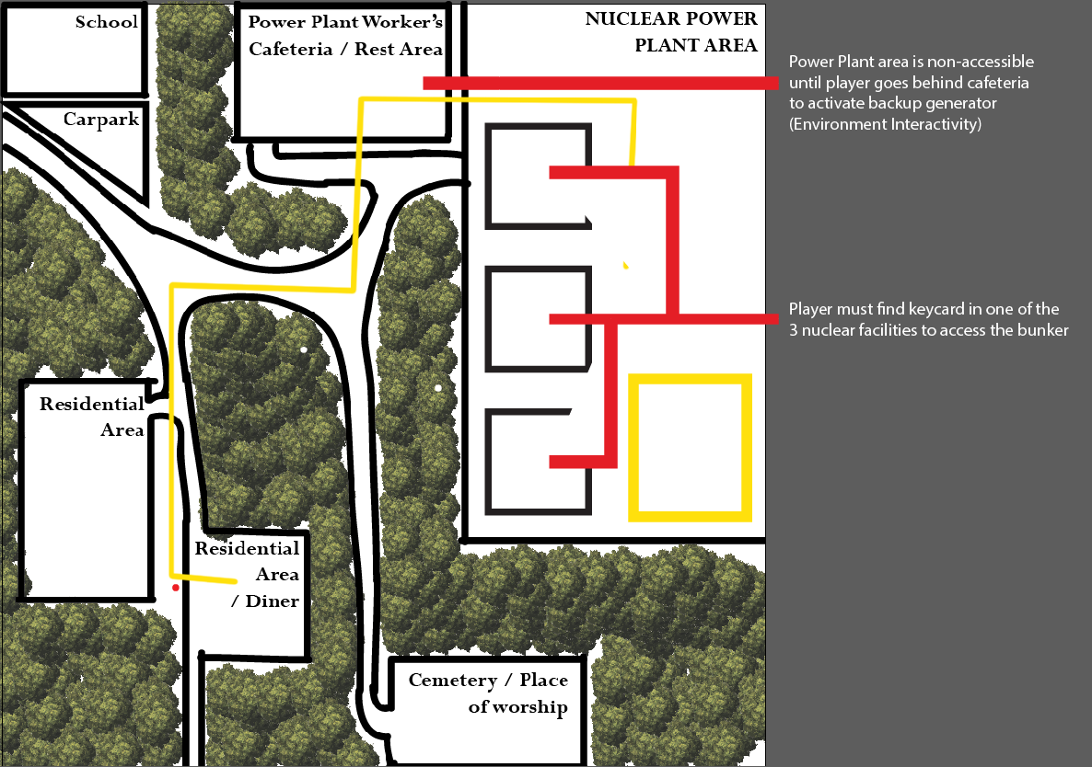
In-game functionality(Interaction)

Slide 4
In-game functionality(Storytelling)
Environmental Storytelling: Bloodborne
Watch from 1:15 until 2:15, this will roughly tell you what Environmental Storytelling is all about

Slide 5
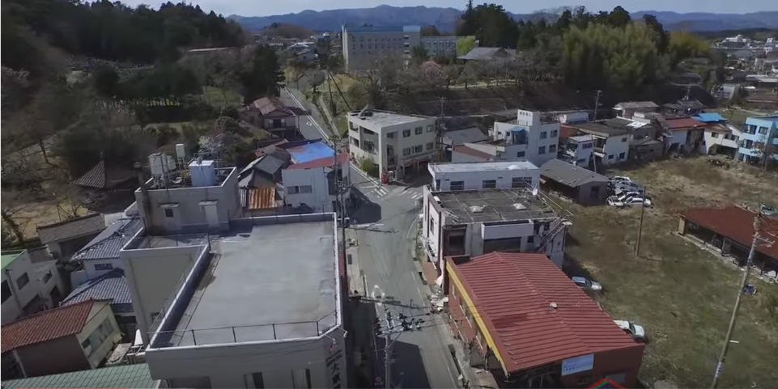
References (Videos / Images)

